Slide 1


Thermal analysis of a 2U CubeSat
Team 18
Parker Southwick, Jeremy Lowman, Katherine Popchock ,Thomas Otero, Tyler Benson and Griffin Johnson

Slide 2
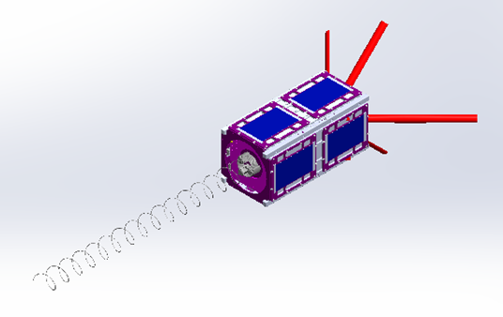
Our CubeSat
2U CubeSat
Project under the CubeSat Launch Initiative (CSLI), NASA Oregon Space Grant Consortium (OSGC) and the Portland State Aerospace Society (PSAS)
Our goal:
Develop an accurate ANSYS model to understand the thermal states that the satellite will undergo at various beta angles and attitudes

Slide 3
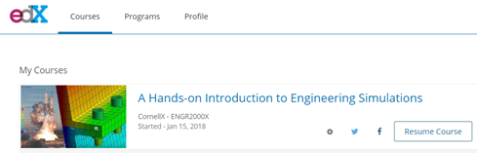
Progress
Winter
Working on completing edX training course through Cornell university
Developed Hand calculations to help build a 2d model
Fall
Onboarding to the OreSat Project
Research of other CubeSat Projects

Slide 4
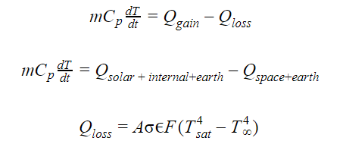
Hand Calculations
These will give us a good idea of what kind of solutions to expect when running analysis in ANSYS.
Lumped capacitance assumes uniform Temperature throughout

Slide 5


Hand Calculations
Energy gains
Losses

Slide 6
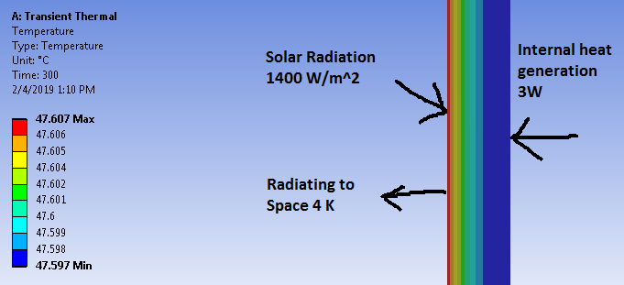
ANSYS Thermal Analysis
Of a single wall.
Simple 2D heat transfer analysis: A cross section of the cubesat wall.
Analysis is ran over a period of 5 minutes (300 s)
Initial temperature of 22 C

Slide 7
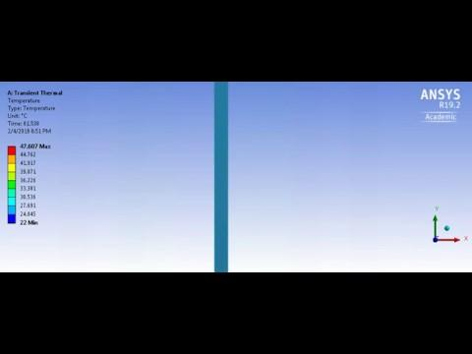
ANSYS Thermal Analysis Of a single wall.

Slide 8
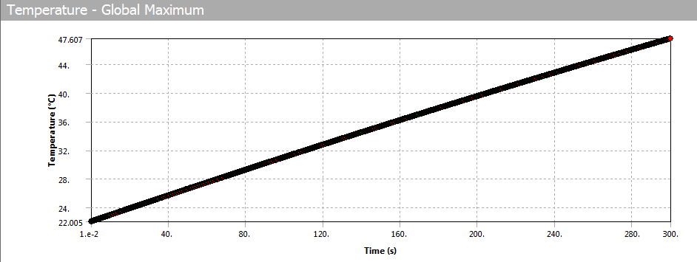
ANSYS Thermal Analysis Of a single wall.

Slide 9
ANSYS Thermal Analysis
ANSYS uses a lot of processing power
More complex models take a very long time to load and run.
Student Version cannot make a fine enough mesh for accurate results.
PSAS should be getting a more powerful computer with full version of ANSYS.

Slide 10
Timeline
Winter term
Complete ANSYS certification
Hand calculations for 1D and 2D complete
1D and 2D results gathered
Begin hand calculations for 3D and creating plausible meshes
Spring term
2D results gathered, begin 3D analysis
Begin verification of simulation data in vacuum chamber
Mesh refinement, continue physical testing
Post-processing of data
Provide actionable suggestions to the OreSat team for attitude control of the satellite

